Slide 1
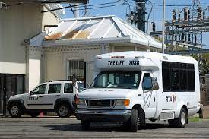


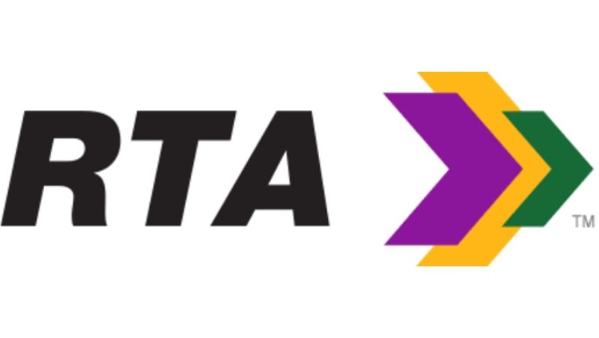
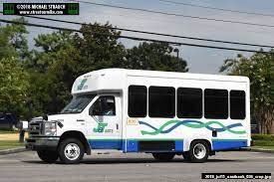



Task 4: Paratransit
Service Profiles
PAC Meeting – July 13, 2022

Slide 2
Presentation Agenda
Introductions / New Members
Review of Tasks & Project Schedule
Task 2: Data Collection
Task 4: Service Profiles
- JP Transit - MITS
- NORTA – The LIFT
Inter-Parish Trips
Next Steps
- Task 3: Community Engagement
- Task 5: Existing Conditions Tech Memo

Slide 3
Project Schedule

Slide 4
Task 2: Data & Information Collected Before/During
Site Visits
Service Model and Division of Responsibilities
Organizational Chart
General Service Design and Policies
  Service area and regional connections
  Service days and hours
  Fares and fare collection
  Reservations hours and booking policies
  Pick-up window policies
  No-show and cancellation policies
  Reasonable accommodation policies
Infrastructure and Supporting Resources
  Facilities and Vehicles
  Technologies

Slide 5
Task 2: Data & Information Collected Before/During
Site Visits
(continued)
Functions
  Eligibility certification and customer registration
  Next-day and advance reservations and scheduling
  Subscription trip requests, scheduling and maintenance
  Run structure
  Dispatching and window dispatching
  Handling customers’ service-day calls
  Trip reconciliation
  Vehicle operations/service delivery
  Driver requirements and training
  Road supervision
  Fleet maintenance
  Trip reconciliation
  Reporting
  Complaint management
  Compliance monitoring

Slide 6
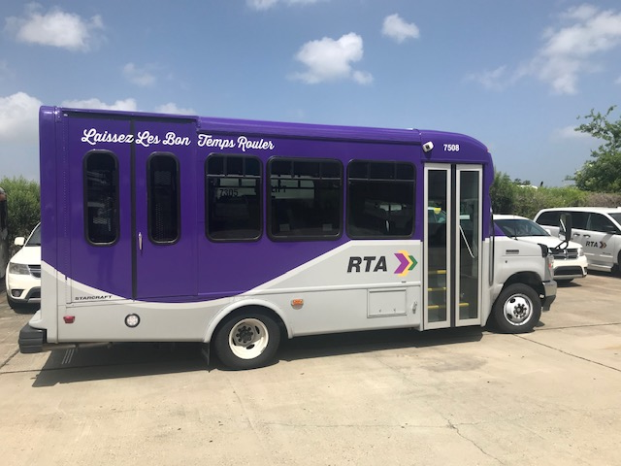
Service Profiles:
NORTA – LIFT Service
Overview
Previously operated under Transdev, transitioned in-house (6/19-12/20)
Under current organizational structure, several functions for LIFT are in different departments
  Mobility and Alternative Modes
  Maintenance
  Marketing (paratransit eligibility)
  IT
  Scheduling and Planning
  Training
  Safety and Emergency Management

Slide 7
Service Profiles:
NORTA – LIFT Service
Service Model and Design
Operated entirely with dedicated vehicles
Covers all of Orleans Parish
Previously interfaced with MITS at three transfer points for inter-parish trips
In March 2022, new policy adopted to directly serve inter-parish trips
$2.00 base fare for one-way trips
Operating hours: 24/7
Reservations hours: 8:00-5:00 (4:00 on Sat/Sun)

Slide 8
Service Profiles:
NORTA – LIFT Service
Standards and Policies
Reservations are made 1-7 days in advance
  Same day booking as available
Subscription trips – minimum 1x per week
On-time pick-up window is 30 minutes (+/-15 min)
  OTP measured for pick-ups only
  Standard set at 90%
  Reported performance – 85%-87%
Cancellations require 2-hour notice
No-show/late cancellation policy
  Escalating suspensions, but not enforced
Reasonable accommodation policy

Slide 9
Service Profiles:
NORTA – LIFT Service
Infrastructure
Most LIFT functions at the East New Orleans (ENO)
Eligibility & IT functions at Canal Street
Fleet of 54 LIFT vehicles – all wheelchair accessible
Stored and maintained at ENO facility
  Vehicle body work and some parts at Canal St
  More vehicles on order
Trapeze software supports service
MDTs, radios and video cameras in the vehicle
  Tablets with Trapeze’s DriverMate on the way later this year

Slide 10
Service Profiles:
NORTA – LIFT Service
Eligibility and Registration
Applications are available online or can be mailed by request
2-part paper review process:
  (1) Applicant information
  (2) Health care professional verification
Max. 21-day period for determination
Appeals process is available
Currently 10,707 customers
  20% of clients are conditionally eligible
  1,000-1,200 active users

Slide 11
Service Profiles:
NORTA – LIFT Service
Reservations and Scheduling
Trapeze used to book and schedule trips
All trips scheduled based on pick-up time
Use 60-75 minute offset from requested drop-off/appointment time to calculate pick-up time
Lead Scheduler works schedule unassigned trips
  If needed, will assign trip to a Road Supervisor
“Will-calls” used for some medical return trips
LIFT schedulers do not employ batch scheduling
  Scheduling parameters on default settings; have not been tuned to New Orleans

Slide 12
Service Profiles:
NORTA – LIFT Service
Subscription Trips and Run Structure
Subscription trips
  Scheduled each day they are served
  Reviewed as needed by Senior Manager
  Approximately 40% of current LIFT service
Current run structure set around morning (39) and afternoon (37) demand peaks
  Use of split shifts help match run structure to demand profile
  24-hour service via one overnight service run
  1-2 extra “tripper” runs sometimes requested when needed and if vehicles/drivers available

Slide 13
Service Profiles:
NORTA – LIFT Service
LIFT Run Structure

Slide 14
Service Profiles:
NORTA – LIFT Service
Dispatching
Trapeze is used to support dispatching
  Dispatchers monitor runs and re-assign trips
  No-show processing; re-emerging no-shows
  Assisting driver and handling customer calls
  Proactive dispatching
Two dispatchers cover peak hours at a time; each dispatcher handles the entire fleet of service
  Overlap in responsibilities
  Issues in handling vehicles with non-working MDTs or radios
  Good coordination in managing vehicle replacements

Slide 15
Service Profiles:
NORTA – LIFT Service
Vehicle Operations and Service
Drivers primarily use MDTs for schedule information; paper manifest as backup
Current MDTs do not have navigation assistance (will be fixed with new tablets)
LIFT is curb-to-curb, but drivers will sometimes assist riders to/from vehicle
Vehicle breakdowns and/or AC issues make it a challenge to provide service
Travel across the river as well as into Jefferson Parish also makes schedule adherence difficult

Slide 16
Service Profiles:
NORTA – LIFT Service
Fleet Maintenance and Fueling
Nearly all maintenance done in-house
  Paratransit group within the Maintenance Department handles the LIFT fleet and any non-revenue vehicles
Ron Turley software used to manage the fleet, preventative maintenance, and work orders
Internal procurement rules have made parts ordering and inventory a major challenge
  Slows down turnaround time to get vehicles back in service
Fueling done remotely (at service stations) via fuel cards

Slide 17
Service Profiles:
NORTA – LIFT Service
Complaints Management
Complaints process detailed in Rider Guide; staff uses Issue Track software
  60 days period to review of available information interviews with parties and respond to rider
  Result: either a Closure Letter or Letter of Finding (which has action steps)

Slide 18
Service Profiles:
NORTA – LIFT Service
Compliance Monitoring
RTA has a goal of zero denials, but it is unclear whether all denials, as defined by FTA, are tracked
Missed trips are tracked, but definition needs to be refined
Late trips are tracked but based on pick-up times; existence of patterns not analyzed
Patterns of excessive ride times not analyzed
Patterns of substandard telephone access not analyzed

Slide 19
Service Profiles:
NORTA – LIFT Service
Big Picture and “Sneak Preview” Items - LIFT
On-time performance substandard, but hampered by lack of vehicles, lack of drivers, non-working MDTs and radios, and untuned software
Complaint frequency ratio – very good
Unit costs are really high
Service efficiency/ productivity is okay
With tuned parameters, batch scheduling
Dispatch needs to be re-organized
Maintenance/parts procurement need attention
New vehicles and tablets on the way – good!
Need for extra capacity and/or to off-load demand

Slide 20
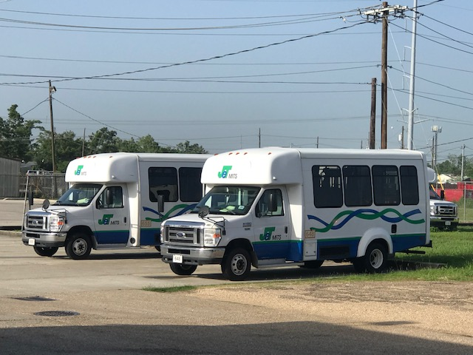
Service Profiles:
JP Transit – MITS Service
Overview
Operated by Transdev - turnkey contract
  Contract includes fixed-route service
  Fixed cost fee plus variable cost fee based on number of revenue hours and floating rate
Transdev contract is overseen and monitored by Jefferson Parish’s Transit Director
Jefferson Parish provides facilities and vehicles
Transdev General Manager oversees Operations, Safety, Maintenance, and IT managers
  Operations Manager oversees call center functions and service delivery

Slide 21
Service Profiles:
JP Transit – MITS Service
Service Model and Design
Operated entirely with dedicated vehicles
Covers most of Jefferson Parish (north of Lafitte) and a limited area of Orleans Parish
Previously transfers with LIFT for inter-parish trips
  Riders now can use MITS or LIFT for inter-parish trips to specific areas in Orleans Parish
$3.00 base fare for one-way trips
Reservations are made 1-7 days in advance
  Same-day booking as available
Operating hours: 4:30-10:30 (5:30a Sat/6:30a Sun)
Reservations hours: 8:00-5:00

Slide 22
Service Profiles:
JP Transit – MITS Service
Standards and Policies
Reservations are made 1-7 days in advance
  Same day booking as available
Subscription trips – minimum 3x per week
On-time pickup window is 30 minutes (+/-15)
  OTP measured for pick-ups only
  Window based on requested time vs. scheduled time, which limits flexibility
  Contractual standard of 88% vs. reported 99%
Two-hour notice required for late cancellations
No-show and late cancellation policy
  Escalating penalties for frequent occurrences
  In practice, not enforced

Slide 23
Service Profiles:
JP Transit – MITS Service
Infrastructure
All MITS functions are handled at the East Bank location in Metairie
  West Bank location in Gretna mostly used for fixed-route maintenance
Fleet of 18 propane vehicles (no CDL required)
  COA vehicles used as backups (CDL required)
Trapeze software supports service
Tablets, radios, video cameras in the vehicles
  DriverMate installed on tablets

Slide 24
Service Profiles:
JP Transit – MITS Service
Eligibility and Registration
Applications are available online or can be mailed by request
2-part paper review process:
  (1) applicant information
  (2) health care professional verification
Max. 21-day period for determination
Appeals process is available
Information on the number of registered and active customers not provided

Slide 25
Service Profiles:
JP Transit – MITS Service
Reservations and Scheduling
Trapeze used to book and schedule trips
All trips scheduled based on pick-up time
Use 60-75 minute offset from requested drop-off/appointment time to calculate pick-up time
Appointment times not noted on driver manifests
“Will-calls” used for some medical return trips
Operation Manager schedules unassigned trips and performs final review
LIFT schedulers do not employ batch scheduling
  Trapeze parameters on corporate settings

Slide 26
Service Profiles:
JP Transit – MITS Service
Subscription Trips and Run Structure
Subscription trips scheduled by Operations Mgr.
  No regular process for review
  Approximately 40% of current MITS service
Current run structure uses 15 runs
  Most runs on 6:00 am to 6:00 pm shift
  Three split shift runs to better serve morning and afternoon peak demand periods
  Flexible to start early of extend later if trip
On-time performance is prioritized over service efficiency

Slide 27
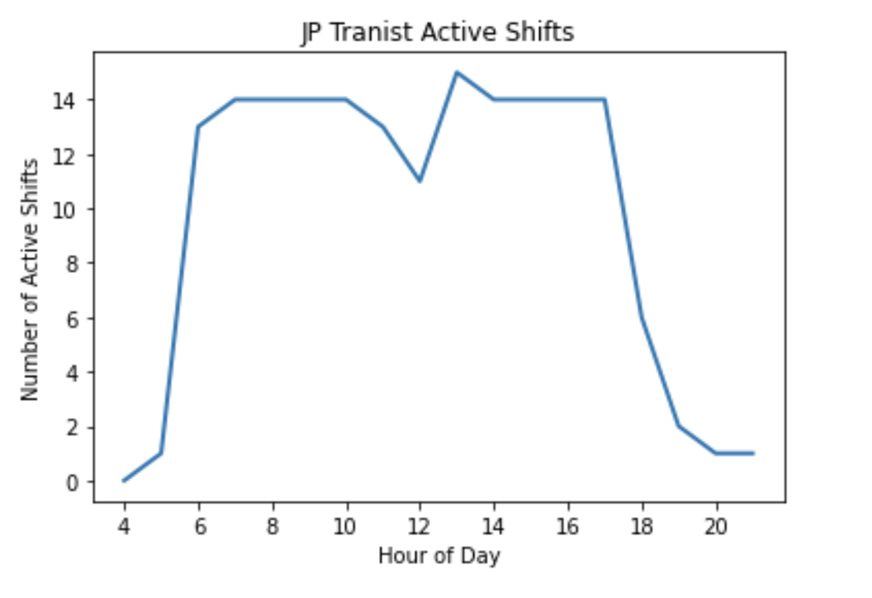
Service Profiles:
JP Transit – MITS Service
MITS Run Structure

Slide 28
Service Profiles:
JP Transit – MITS Service
Dispatching
Trapeze is used to support dispatching
  Dispatchers monitor runs and re-assign trips
  No-show processing; re-emerging no-shows
  Assisting driver and handling customer calls
Two staff at a time handle all call center functions
  A third person would be the designated dispatcher (currently down one person)
  Challenge to focus on all functions equally
  Tablets help with monitoring vehicles
  100% calls to possible no-showing riders
  Imminent-arrival calls to apartment dwellers
  Unaware of missed trip vs. no-show distinction

Slide 29
Service Profiles:
JP Transit – MITS Service
Vehicle Operations and Service
Drivers primarily use tablets for schedule information; paper manifest as backup
  Only scheduled (vs. estimated) time on tablet
MITS is curb-to-curb, but drivers will sometimes assist riders to/from vehicles
Vehicle AC and tablet SIM card issues make it a challenge to provide service
  COA vehicles used as backups (which do not have tablets and require CDL drivers)
Propane vehicles sometimes stall during service; can present safety issue

Slide 30
Service Profiles:
JP Transit – MITS Service
Fleet Maintenance and Fueling
Nearly all maintenance done in-house
  All MITS fleet maintenance and repairs are done at the East Bank facility
Maintenance of tablets is handled by IT
Ron Turley software used for logging preventative maintenance and work orders
Solution (local firm) tracks monthly maintenance information sent by JP Transit
All fueling of vehicles (propane) done at East Bank facility by maintenance staff

Slide 31
Service Profiles:
JP Transit – MITS Service
Complaints Management
Customers are directed to call MITS Manager for complaints (no other steps specified)
Complaints are logged in Trapeze
Operations Manager conducts a review of available information and determination
So far in 2022, only 2 complaints reported

Slide 32
Service Profiles:
JP Transit – MITS Service
Compliance Monitoring
JP Transit has a goal of zero denials, but it is unclear whether all denials, as defined by FTA, are tracked
Missed trips are not be tracked
Late trips are tracked but based on pick-up times; existence of patterns not analyzed
Patterns of excessive ride times not analyzed
Patterns of substandard telephone access not analyzed

Slide 33
Service Profiles:
JP Transit –
MITS Service
Big Picture and “Sneak Preview” Items - MITS
On-time performance at 99% (reported) points to high quality service, although OTP is based on pick-up time only
Complaint frequency ratio – exceptional; however, it is possible that not all complaints are recorded
Unit costs are much lower than LIFT’s unit costs
Service efficiency/ productivity is okay; could possibly be improved without decline in OTP
With better tuned parameters, batch scheduling
Getting back dedicated dispatcher will help
Possible staging of vehicles at West Bank facility

Slide 34
Key Topic:
Inter-Parish Trips
Previous Process Using Transfer Points
Three transfer points
Customers called both MITS and LIFT to arrange their going and return trips
  Two round trips for each 1 inter-parish round trip
Combined fares where $5 for a one-way trip ($10 for both trips)
Most trips were arranged as standing order/subscription trips

Slide 35
Key Topic:
Inter-Parish Trips
Issues Leading to LIFT Policy Change
Lighthouse employees had frequent issues with getting to work on time or getting left at transfer point
Probable causes:
  Differences in how linked trips were requested and scheduled may have resulted insufficient time for the transfer
  Late running vehicles get to transfer point after first vehicle came and went
  Disconnect between dispatchers of the two services
  Both services have a “drop and go” policy for transfers

Slide 36
Key Topic:
Inter-Parish Trips
Premise for Having Transfers
Consistent with the fixed route system
  ADA paratransit is complementary to conditions of fixed route service
Transfers keep each systems’ vehicles local
  Typically results in increased productivity (depending on other factors)
Transfers tend to dampen the demand for discretionary inter-area trips
  Further improving productivity

Slide 37
Key Topic:
Inter-Parish Trips
Actions by Other Agencies to Improve Transfers
Dispense with the “drop-and go” policy
  First vehicle waits for second vehicle to arrive
  Rider hand-off
Implement a “hotline” between the two agencies’ dispatchers
Deploy a road supervisor or staff at the transfer point with access (e.g., LA’s Access Services) to both sets of dispatchers
Implement a policy where rider has to only make one call to request trip
  Intaking agency arranges for transfer with the other agency

Slide 38
Key Topic:
Inter-Parish Trips
NORTA Policy Change in March 2022
Unilateral decision to eliminate transfers for the Lighthouse riders
  Intended to improve experience and safety
Decision made without cooperative planning between agencies
New policy has not been broadcast; but word of mouth is spreading to other MITS customers
  LIFT staff will make trip reservations for other inquiring, registered customers
MITS is now also serving inter-parish trips
Result: Longer trips/deadheading for both agencies as well as possible service duplication

Slide 39
Key Topic:
Inter-Parish Trips
Alternative Policies to Consider
May be difficult to go back to transfers
If transfers are not re-instated, there are two possible schemes to implement:
  Rider calls the system responsible for the area in which the trip originates (for each trip) – e.g., rider would have to call MITS for the going trip and LIFT for the return trip (e.g., LA)
  Customer calls the system based on residence -- e.g., MITS would handle the entire round trip for a Jefferson-Orleans-Jefferson round trip
Both would lesson service duplication
Scheme two requires rider to make only one call

Slide 40
Task 3:
Outreach
Plan
Outreach Plan will include:
15 stakeholder interviews
4 rider focus groups
- 2 for Lift riders (day, evening)
- 2 for MITS riders (day, evening)
2 open houses to present/discuss draft recommendations
- 1 in New Orleans
- 1 for Jefferson Parish
Project website (NORPC)
Input to be synthesized in Final Report
Stakeholder Interviews
June-July
Rider Focus Groups mid-July
Open Houses
Mid-November

Slide 41
Task 5:
Existing Conditions
Functional Assessment of Both Services
Ridership and Demand (trends)
Telephone Access
Service and Cost Efficiency
Service Quality
Safety and Maintenance
ADA Compliance
Focused Assessments: Eligibility Certification
Call Center Assessment
Software Assessment
Complaint Management
Contract Assessment (JeT)

Slide 42
Task 5:
Peer Review
Peer Review
Peer identification methodology
5-6 peers for each service
4 “final” peers for each service
Outreach to determine survey participations
Draft survey form (questions) to PMC for input
Qualtrics Survey
Task 5 Technical Memorandum & PMC Meeting
Functional Assessments
Peer Review Findings

Slide 43
Task 6:
Improvement Strategies
Changes to policies and practices per function and/or organizational structure
AlphaPlan simulations
Simulation #1: Optimize Run Structure/Fleet Mix
Simulation #2: Optimize Service Mix
Simulation #3: Integrate Two Systems
Choice between #2 and #3 for second simulation;
TTI recommends #2

Slide 44
Task 7:
Recommendations
Each recommendation will include:
Narrative description of the change
Challenges addresses / goals achieved
Predicted benefits to service/cost efficiency, service quality, compliance issues, etc.
Implementation plan and schedule
- categorized into short-term (0-3 years) and
medium-term (4-10 years)
Presented at Open Houses
Summary Report

Slide 45
Task 8:
Final Deliverable
Draft Final Report
- will include an Executive Summary and
findings from all tasks
PMC to review
- one consolidated set of comments
Final Report
- digital copy
- by December 2022

